Slide 1



Building a Text Summarizer
By
Mayank Kumar
Data Scientist at Srijan Technologies
Date: 29-02-2020 | Venue: Srijan Technologies, New Delhi

Slide 2
Who am I?
Mayank Kumar
Data Scientist at Srijan Technologies
Kaggle Competitions Expert
Won few competitions in the past:
Analytics India Magazine - Identify the author Challenge by Machine Hack (rank 2)
ZS Young data scientist challenge 2018 by Hackerearth (rank 3)
World data science challenge by Bitgrit (rank 4)
Also a competitive programmer:
Won 2 silver and 3 bronze medals at Hackerrank
B.Tech Gold Medalist in Academics
Hobbies : Competitive ML, Algorithms design, Anime series lover
Can be reached at
Linkedin (https://www.linkedin.com/in/mk9440/)
Kaggle (https://www.kaggle.com/mk9440)
Other profiles can be accessed at mk9440 as well

Slide 3
What is Text Summarization?

Slide 4
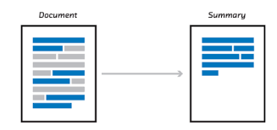
What is Text Summarization?

Slide 5
What is Text Summarization?
Text summarization is the process of shortening a set of data computationally, to create a subset (a summary) that represents the most important or relevant information within the original content.^{src: wikipedia}
Text summarization is the technique for generating a concise and precise summary of voluminous texts while focusing on the sections that convey useful information, and without losing the overall meaning.^{src:floydhub}

Slide 6
Various approaches for text summarization?
Extractive Summarization
Abstractive Summarization

Slide 7
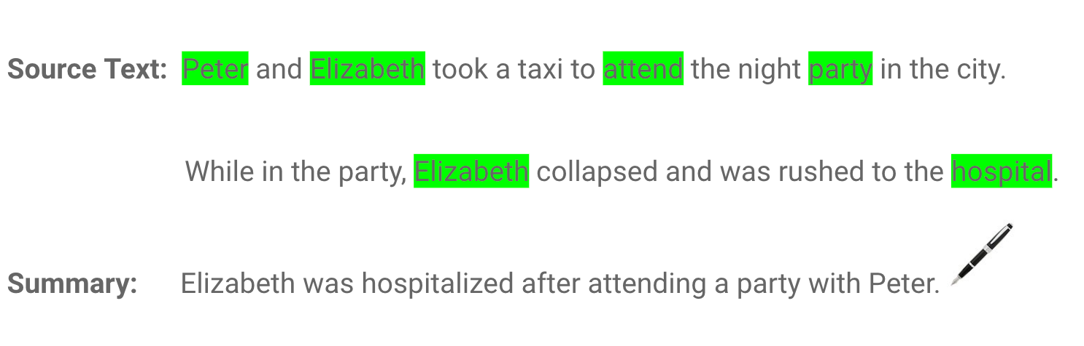
Various approaches for text summarization?
Extractive Summarization
Abstractive Summarization

Slide 8
Various approaches for text summarization?
Extractive Summarization
Extractive summarization means
identifying important sections
(sentences or paragraphs or
even words) of the text
and selecting (copy paste) them
producing a subset of the text
from the original text.
Abstractive Summarization
Abstractive summarization is the
technique of generating a summary
of a text from its main ideas, not by
copying verbatim most salient
sentences from text.

Slide 9

Approaching Extractive Summarization?

Slide 10
Approaching Extractive Summarization?
One approach could be to create a semantic representation of sentences.

Slide 11
Approaching Extractive Summarization?
One approach could be to create a semantic representation of sentences.
Following can be used to create a semantic representation for texts:
Count-based techniques like CountVectorizer, Tf-Idf Vectorizer
Pretrained word embeddings based techniques like Word2Vec, Glove, fastText
Pretrained SOTA transformers like BERT (or its variants) to better capture context as well.
Train your own (quite cumbersome :( )

Slide 12
Approaching Extractive Summarization?
One approach could be to create a semantic representation of sentences.
Following can be used to create a semantic representation for texts:
Count-based techniques like CountVectorizer, Tf-Idf Vectorizer
Pretrained word embeddings based techniques like Word2Vec, Glove, fastText
Pretrained SOTA transformers like BERT (or its variants) to better capture context as well.
Train your own (quite cumbersome :( )
Now comparison can be done between each sentences as they are no more a sequence of characters and words but a numerical vector now.

Slide 13
Approaching Extractive Summarization?
One approach could be to create a semantic representation of sentences.
Following can be used to create a semantic representation for texts:
Count-based techniques like CountVectorizer, Tf-Idf Vectorizer
Pretrained word embeddings based techniques like Word2Vec, Glove, fastText
Pretrained SOTA transformers like BERT (or its variants) to better capture context as well.
Train your own (quite cumbersome :( )
Now comparison can be done between each sentences as they are no more a sequence of characters and words but a numerical vector now.
Use the comparisons to score each sentences and pick the top scored ones as your
summary.

Slide 14
Approaching Extractive Summarization?
One approach could be to create a semantic representation of sentences.
Following can be used to create a semantic representation for texts:
Count-based techniques like CountVectorizer, Tf-Idf Vectorizer
Pretrained word embeddings based techniques like Word2Vec, Glove, fastText
Pretrained SOTA transformers like BERT (or its variants) to better capture context as well.
Train your own (quite cumbersome :( )
Now comparison can be done between each sentences as they are no more a sequence of characters and words but a numerical vector now.
Use the comparisons to score each sentences and pick the top scored ones as your
summary.
Scoring technique needs to be intelligent enough to properly evaluate what are the
information content of a sentence and thus score it accordingly.

Slide 15
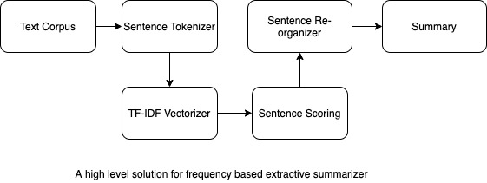
Approaching Extractive Summarization?

Slide 16

Let’s be practical…….
Fire up your Notebooks

Slide 21
Any Questions ?

Slide 22
References / Credits
https://blog.floydhub.com/gentle-introduction-to-text-summarization-in-machine-learning/
https://medium.com/@ondenyi.eric/extractive-text-summarization-techniques-with-sumy-3d3b127a0a32
https://en.wikipedia.org/wiki/Automatic_summarization

Slide 23
Thank You
Head Offices
2430 Highway 34
Building B, Suite 22
Manasquan, NJ 08736, USA
8D Vandana Building, Tolstoy Marg,
New Delhi 110001, INDIA
email: business@srijan.net
web: srijan.net
twitter: @srijan

